Slide 1
What is Linux
Linux is a generic term referring to Unix-like graphical user interface (GUI) based computer operating systems.
It is Multi-user, Multitasking, Multiprocessor
Has the X Windows GUI
Coexists with other Operating Systems
Runs on multiple platforms
Includes the Source Code

Slide 2
Why is it important?
Powerful
  Runs on multiple hardware platforms
  Users like its speed and stability
  No requirement for latest hardware
It’s “free”
  Licensed under GPL
  Vendors are distributors who package Linux

Slide 3
Operating System
Multiprocessing
An operating system capable of supporting and utilizing more than one computer processor.
Multi-user
A multi-user operating system allows for multiple users to use the same computer at the same time and/or different times.
Multithreading
Operating systems that allow different parts of a software program to run concurrently. Operating systems that would fall into many category

Slide 4
Operating System
Multitasking
An operating system that is capable of allowing multiple software processes to run at the same time.

Slide 5
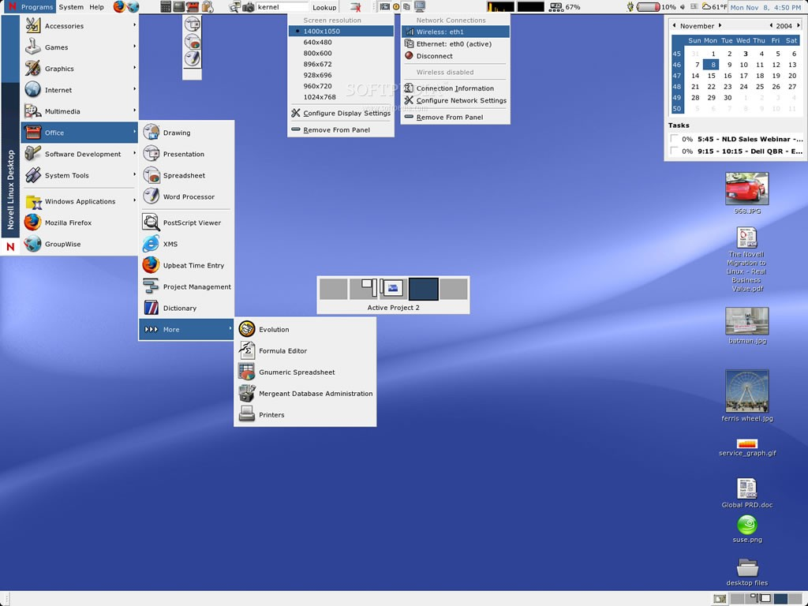

Slide 6
Why Ubuntu is safe
Ubuntu is secure by default for a number of reasons:
Ubuntu clearly distinguishes between normal users and administrative
Users.
Sftware for Ubuntu is kept in a secure online repository, which contains no false or malicious software.
Open-source software like Ubuntu allows security flaws to be easily
detected.
Security patches for open-source software like Ubuntu are often released quickly.
Many viruses designed to primarily target Windows-based systems do
not affect Ubuntu systems.

Slide 7
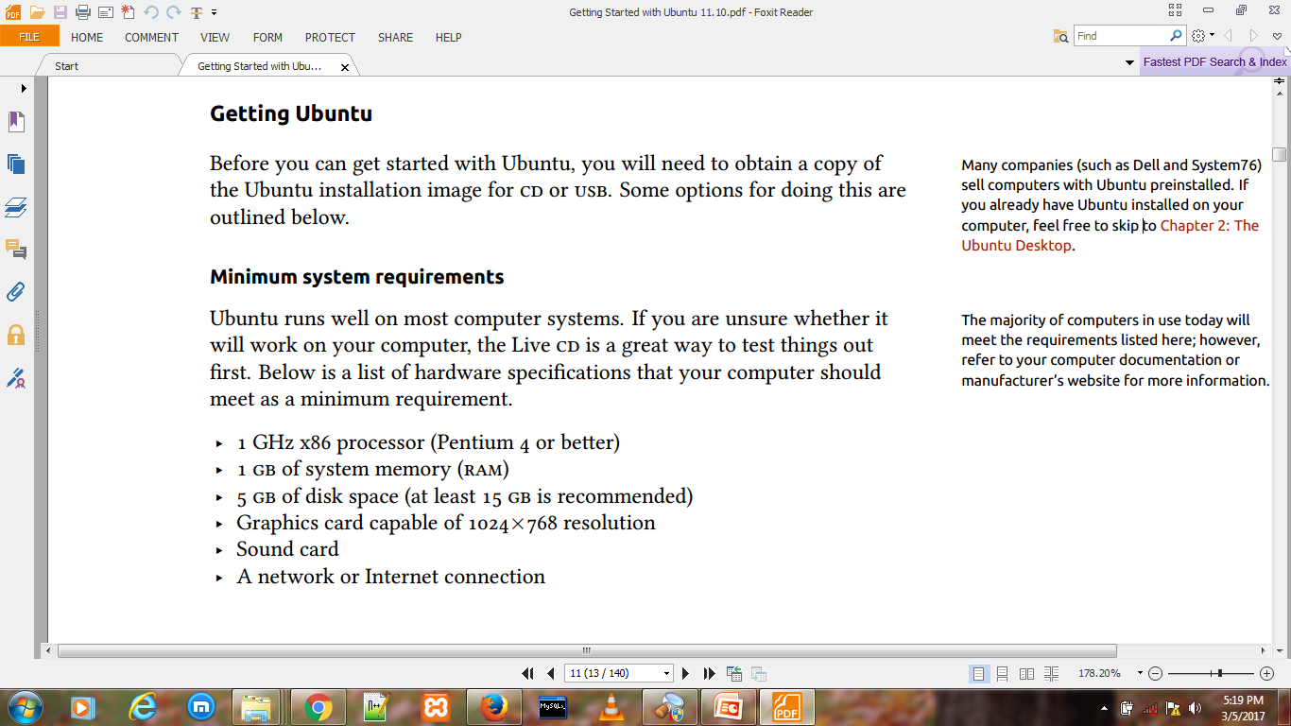
Installation Requirement
“GPL” stands for “General Public License”.
The license was originally written by Richard Stallman of the Free Software Foundation (FSF) for the GNU Project, and grants the recipients of a computer program the rights of the Free Software Definition.
The most widespread such license is the GNU General Public License, or GNU GPL for short. This can be further shortened to “GPL”, when it is understood that the GNU GPL is the one intended.

Slide 8
What is GPL ?
“GPL” stands for “General Public License”.
The license was originally written by Richard Stallman of the Free Software Foundation (FSF) for the GNU Project, and grants the recipients of a computer program the rights of the Free Software Definition.
The most widespread such license is the GNU General Public License, or GNU GPL for short. This can be further shortened to “GPL”, when it is understood that the GNU GPL is the one intended.

Slide 9
What is GPL ?
Short for General Public License, GPL is intended to guarantee your freedom to share and change free software--to make sure the software is free for all its users.
This GPL applies to most of the Free Software Foundation's software and to any other program whose authors commit to using it.
The GNU GPL or GPL is a widely used free software license, which guarantees end users the freedom to run, study, share and modify the software.

Slide 10
What is GPL ?
the GPL license family has been one of the most popular software licenses in the free and open-source software domain.
Prominent free software programs licensed under the GPL include the Linux kernel and the GNU Compiler Collection (GCC).
Short for General Public License, the license that accompanies some open source software that details how the software and its accompany source code can be freely copied, distributed and modified.

Slide 11
What is GPL ?
The most widespread use of GPL is in reference to the GNU GPL, which is commonly abbreviated simply as GPL when it is understood that the term refers to the GNU GPL.
One of the basic tenets of the GPL is that anyone who acquires the material must make it available to anyone else under the same licensing agreement.
The GPL does not cover activities other than the copying, distributing and modifying of the source code.

Slide 12
What is GNU/Linux?
GOVERNMENT NATIONAL UNITY
Short for GNU's not Unix, GNU is a free software project to provide a distributable replacement for Unix.
GNU was first announced by Richard Stallman on September 27, 1983 and later published in the March 1985 issue of Dr. Dobb's Journal.
The aim of GNU is to give all computer users the freedom of copying, developing, distributing, modifying and studying software with the understanding that its redistribution cannot be limited.
The goal of the project was achieved in 1992 when Linux was released under the GNU General Public License.

Slide 13
What is GNU/Linux?
These tools enable users to perform tasks ranging from the physical (such as copying or removing files from the system) to the arcane.
While many groups and individuals have contributed to Linux, the largest single contributor is still the Free Software Foundation, which created not only most of the tools used in Linux, but also the philosophy and the community that made Linux possible.
The Linux kernel first appeared in 1991, when a Finnish computing science student named Linus Torvalds announced an early version of a replacement kernel for Minix to the Usenet newsgroup comp.os.minix.

Slide 14
What is freeware ?
Alternatively referred to as free software, freeware is software that is made available 100% free as long as it remains un-modified. The complete opposite of freeware is commercial software. Unlike open-source software, freeware cannot be modified and is often only licensed to be used by non-commercial users.
Definition - What does Freeware mean?
Freeware is any copyrighted software, application or program that may be freely downloaded, installed, used and shared. Such programs are available for use at no cost to general end users. Freeware differs from free software, as the latter allows a user to modify source code for republishing or integration with other software.

Slide 15
What is freeware ?
As small software utilities, freeware is free to use throughout its lifetime because it does not expire after a certain period. Freeware may be used for a desktop, mobile or Web-based utility.
Generally, freeware is a concise and limited version of a larger and paid software program. Vendors publish freeware to provide a limited but free version of software to prospective buyers prior to purchase. Additionally, large independent software vendors (ISV) publish freeware to enhance brand buzz and market reputation.

Slide 16
Open source software
Ubuntu is open source software.
Open source software differs from proprietary software—software whose source code is not freely available for modification or distribution by anyone but the rightsholder.
Microsoft Windows and Adobe Photoshop are examples of proprietary software.
Unlike proprietary software applications, the software included with Ubuntu is specifically licensed to promote sharing and collaboration.

Slide 17
Open source software
The legal rules governing Ubuntu’s production and distribution ensure that anyone can obtain, run, or share it for any purpose she or he wishes.
Computer users can modify open source software like Ubuntu to suit their individual needs, to share it, to improve it, or to translate it into other languages—provided they release the source code for these modifications so others can do the same.
In other words, open source software is updated, enhanced, and made more secure every day as programmers all over the world continue to improve it.

Slide 18
Open source software
Aside from these technical advantages, open source software also has economic benefits.
While users must adhere to the terms of an open source licensing agreement when installing and using Ubuntu, they needn’t pay to obtain this license.
And while not all open source software is free of
monetary costs, much is.

